Slide 1
Alignment of EU-China Funding Schemes and Opportunities in the Water Sector
Water and Energy Security

Slide 2
Alignment of EU-China Funding Schemes and Opportunities in the Water Sector
Water and Energy Security
01
Introduction
02
Summary of Key Findings
CONTENTS
03
Next Steps

Slide 3
01 Introduction
Aim of the Study
Explore water-related issues of common interest in research and funding between Europe and China.
Contribute to the alignment of funding opportunities for business, research and innovation between Europe and China in the Water sector.
Contents of the Study
Overview of the Research Landscape in Europe and China
Overview of the Water Sector in Europe and China
Research and innovation water project trends in Europe and China
Cooperation research needs and gaps in key areas between Europe and China per research theme
Recommendations on future cooperation

Slide 4
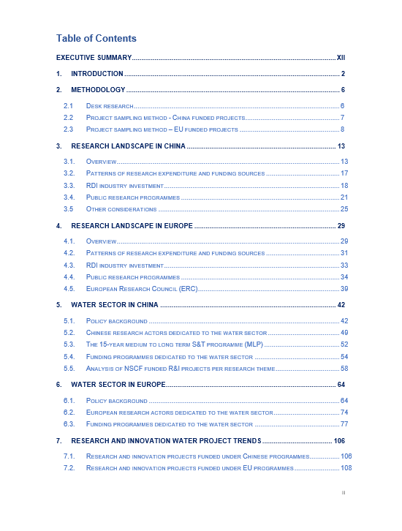
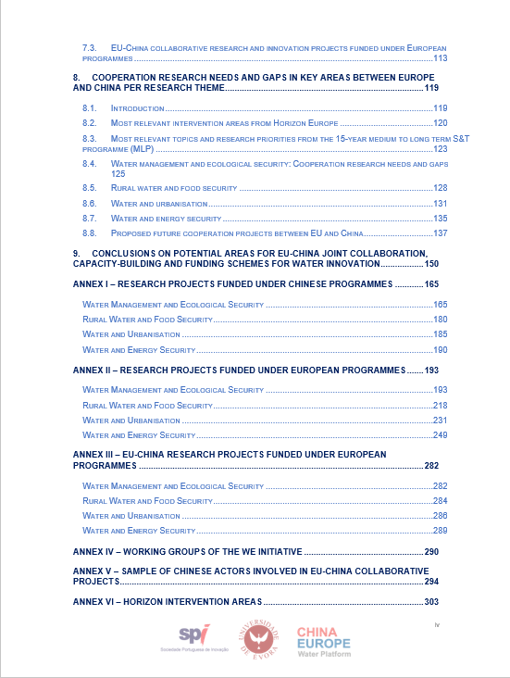
01 Introduction

Slide 5



01 Introduction
A sample of more than 250 water-related R&I projects funded under FP7, H2020, and NSFC programmes was examined and analyzed, including EU-China collaborative projects under FP7 and H2020.
Of more than 250 identified project, 75 projects are related to Water and Energy Security research theme
Search on Chinese National Knowledge Infrastructure database, ScienceNet and CORDIS database for each of the four themes using the following key words:
  Water Management and Ecological Security: ‘Water Management Ecolog’;
  Rural Water and Food Security: ‘Rural Water Food’;
  Water and Urbanisation: ‘Water Urbanisation’;
  Water and Energy Security: ‘Water Energy’.
Methodological
Approach

Slide 6
02 Summary of Key Findings
H2020 and FP7
project trends
Water and Energy Security
The number of projects supported in this field is 2% higher under H2020, with the budget allocated in H2020 in this field of expertise being around 24% superior as compared to FP7 (Figures 1 and 2)
Average EU contribution per project was 80% of the total budget.
The average duration of the project was 36 months.
Figure 1: Number of Projects
Figure 2: EU Contribution

Slide 7
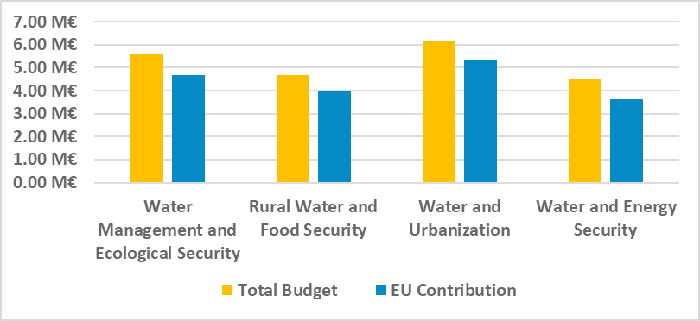
02 Summary of Key Findings
H2020 and FP7
project trends
Water and Energy Security
Most frequent topic was H2020-WATER-2015-two-stage: Water Innovation: Boosting its value for Europe (6 projects)
From the identified H2020 and FP7 projects, the highest project average funding was related to the Water and Urbanisation and the Water Management and Ecological Security research themes (Figure 3).
Figure 3: Average EU project value per focus area

Slide 8
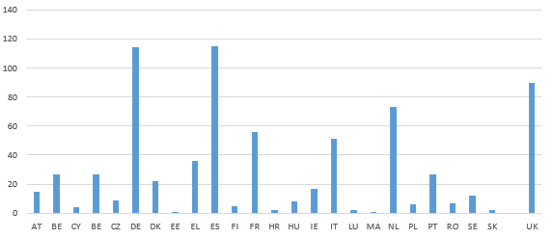
02 Summary of Key Findings
H2020 and FP7
project trends
Water and Energy Security
Highest participation was observed from Business organisations (46%), followed by Research organisations (21%), Higher education establishments (21%) and Public organisations (5%).
Organisations from 24 Member States have been involved in projects, with the highest number of organisations from Spain, Germany and Netherlands (Figure 4).
Figure 4: Participation of organisations from EU-27

Slide 9
02 Summary of Key Findings
H2020 and FP7
project trends
Water and Energy Security
In terms of typology, most projects consisted of activities related to Collaborative Action (FP7) and Research and Innovation Actions (H2020)
Projects were funded through four different topics under FP7 and through six topics in H2020
The most common topic among the sample of projects was “Water”
Figure 5: FP7 - project areas
Figure 6: H2020 - project areas

Slide 10
02 Summary of Key Findings
H2020 and FP7
project trends
Water and Energy Security
Majority of projects were dedicated towards energy saving (79%).
H2020 and FP7 projects targeted primarily the same areas of R&I.
H2020 projects had a broader research domain.
H2020 included more projects focused on energy saving together with other, crosscutting issues (wastewater, agriculture, water).
Figure 7: Types of projects funded between 2007-2020

Slide 11
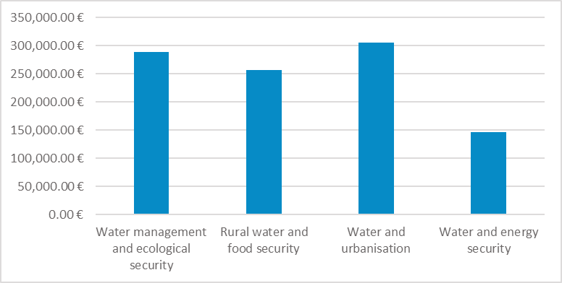
02 Summary of Key Findings
Overall NSFC project trends
Water and Energy Security
The average budget allocated for each organisation was EUR 145,000.
Among the identified sample of projects, the most common topic was Engineering hydrology and water resources use (7 projects).
The average project duration was 40 months.
From the identified NSFC projects, the highest project average funding was related to the Water and Urbanisation and the Water Management and Ecological Security research themes (Figure 5).
Figure 8: Average NSFC project value per focus area

Slide 12
02 Summary of Key Findings
Overall NSFC project trends
Water and Energy Security
The projects (n=9) from the Water and energy security sector, for the period of 2010 to 2020, had a total cumulative budget of EUR 1.3 million.
The average project value was EUR 146,133.
Of the 9 projects, 1 project (11%) was funded under the Key Programme with a total cumulative budget of EUR 0.3 million.
The remainder, 8 projects (89%), was funded under the Joint Fund Programme with a total cumulative budget of EUR 1.0 million
Figure 9: Number of projects for Water and Energy
Figure 10: Project values for Water and Energy

Slide 13
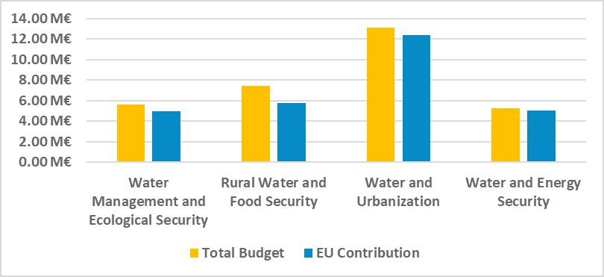
02 Summary of Key Findings
EU-China collaborative
project trends
Average EU contribution was 90% of the total budget.
The average project duration was 52 months, with the longest project having a duration of 60 months and the shortest project having a duration of 36 months.
In the projects where Chinese participants were involved, the highest project average funding was related to the Water and Urbanisation and the Rural Water and Food Security research themes (Figure 6).
Only one project identified within water and energy research theme where Chinese participants were involved – CD-Links.
Figure 11: Average EU-China collaborative project value per focus area

Slide 14
02 Summary of Key Findings
The most common topic among of the sample of projects was “SCC-02-2016-2017 - Demonstrating innovative nature-based solutions in cities”.
The highest number of projects was funded under the programme: H2020 - 3.5. - SOCIETAL CHALLENGES - Climate action, Environment, Resource Efficiency and Raw Materials.
EU-China collaborative
project trends
With regards to the funding schemes, most of the projects consisted of activities related to the Research and Innovation Action and the Innovation Action (Figure 7).
Figure 12: Typology of projects

Slide 15
02 Summary of Key Findings
On average, two Chinese partners were involved in one EU-China collaborative project.
Organisations from 22 EU-27 Member States have been involved in the identified projects, with the highest number of organisations from Spain, Italy and Netherlands (Figure 8).
The highest number of organisations from China participated in projects related to Water Management and Ecological Security research theme.
EU-China collaborative
project trends
Figure 13: Participation in the EU-China collaborative projects per country

Slide 16
02 Summary of Key Findings
Overall outcomes of the Study
Common areas of interest between EU and China with links to key policy objectives and priorities of:
  a) The 15-year medium to long term S&T programme
  b) EU Green Deal Policy Areas
  c) Horizon Europe Clusters and Intervention Areas and
  d) EU-China Strategic Outlook priorities.
Relevant funding schemes in the context of Horizon Europe and the upcoming 14th FYP.
Good practice examples of the EU-China collaboration.
Important trends and considerations regarding EU and Chinese funded water R&I projects.
Cooperation research needs and gaps in key areas between Europe and China per research theme.

Slide 17

03 Next Steps
Key outcomes of the round table discussion will be presented during the round table joint session scheduled for the 21st of April.
Based on the outputs from round table discussions, further recommendations for the alignment of EU-China funding programmes will be developed.
Final version of the Inventory Study that will integrate the outcomes of roundtables will be completed in June 2021.
Final version of the Inventory Study
Research

Slide 18
03 Next Steps
Partnerships Water4All
Missions
General WP
Horizon
Europe
International cooperation
Excellence
Innovative
EIC
Based on the outputs from round table discussions, further recommendations for the alignment of EU-China funding programmes will be developed.
Key outcomes of the round table discussion will be presented during the round table joint session scheduled for the 21st of April.
Final version of the Inventory Study that will integrate the outcomes of roundtables will be completed in June 2021.
Major S&T Projects (Mega Projects)
National Natural Science Fund
Chinese FP
China’s National Key R&D Programmes
Technology Innovation Guidance Fund
International Cooperation
Bases and Talents Programme

Slide 19
03 Next Steps

Slide 20

03 Next Steps
Application

Slide 21

Thank you!
www.spieurope.eu
Dr. Sara Medina – Member of Board of SPI
saramedina@spi.pt
WeChat ID: tennis18sara
Dr. Ana Mendes – University of Evora
aimendes@uevora.pt
Richard Deng – Chief Representative of SPI China
richarddeng@spi-china.cn
WeChat ID: letswine
Igor Kosic – International Consultant
igorkosic@spi.pt
Johnny Pan – International Consultant
johnnypan@spi-china.cn
WeChat ID:johnnypan119
Xinting Shao – International Consultant
xintingshao@spi-china.cn
WeChat ID: xintingshao
Twitter @ChinaEUwater
#CEWP www.cewp.eu cewp.mwr.gov.cn
This action is co-funded by the European Union and P.R. China. The project partners are solely responsible for the contents, which do not necessarily reflect the views of the funding parties.

